Slide 1
Monday 18th May 2026
House Price Index
The largest monthly sample of residential property prices and housing market activity
+1.2%
-4%
5.18%
Prices up 1.2% since April, slightly higher than the 10-year average of 1.0% for May
Sales agreed remain steady, 4% below last year’s market but up 2% on 2024
Average two-year fixed mortgage rate falls to 5.18% from 5.42% last month
Affordability drives a north-south price growth divide, but market remains confident
Average price of property coming to market rises by 1.2% (+£4,333) in May to £378,304, exceeding the typical ten‑year May increase of 1.0% as market confidence remains surprisingly strong. However prices have fallen by 0.3% since May 2025
  Buyer choice is at its highest for this time of year since 2015, and with 32% of existing homes for sale seeing a price reduction, new sellers need to price more competitively, as over-optimistic initial pricing is leading to longer selling times
The housing market remains confident overall despite global uncertainty and resulting cost-of-living pressures, with the number of sales agreed just 4% below last year when mortgage rates were significantly lower, yet still up 2% on the same period in 2024
  The number of sales agreed in the heavily mortgage-dependent first-time buyer sector is continuing to hold up (also 4% below last year) but is dependent on lenders continuing to lend at higher Loan-To-Value ratios
  In this sector we have also seen an annual drop in average prices of 0.7% which is helping to ease affordability at the entry level, contrasting to the 0.3% national fall in prices for the market overall
However, buyer affordability is driving a clear year-on-year north–south divide in price growth, with the more affordable North East (+2.7%) and North West (+2.6%) continuing to grow, while London (‑2.4%) and the South East (‑1.6%) are seeing price falls
Rightmove’s daily mortgage tracker shows that the average two‑year fixed rate has dropped to 5.18%, from 5.42% last month, providing a small but welcome boost to buyer confidence and affordability
National average asking price
Month | Avg. asking price | Monthly change | Annual change | Index
May 2026 | £378,304 | +1.2% | -0.3% | 292.5
April 2026 | £373,971 | +0.8% | -0.9% | 289.1
National average asking price by market sector (excluding inner London)
Sector | May 2026 | April 2026 | Monthly change | Annual change
First time buyers | £228,048 | £227,399 | +0.3% | -0.7%
Second-steppers | £350,407 | £347,347 | +0.9% | +0.5%
Top of the ladder | £704,957 | £688,958 | +2.3% | +0.1%
Rightmove measured 122,800 asking prices this month nationally. The properties were put on sale by estate agents from 12th April – 9th May 2026 and advertised on Rightmove.co.uk.
Copyright © 2026, Rightmove plc. Released 18th May. For media enquiries and interviews please contact the Rightmove press office:
M 07814 902 706 E press@rightmove.co.uk

Slide 2
Monday 18th May 2026
Page 2
Above average May price growth highlights surprisingly strong market confidence
The average price of newly-listed homes for sale rises by 1.2% (+£4,333) in May to £378,304, exceeding the typical ten-year May increase of 1.0% and signalling a stronger than usual seasonal uplift. Housing market activity remains surprisingly confident overall despite global uncertainty and the resulting cost-of-living pressures.
However, despite this broadly resilient monthly snapshot, buyer affordability is driving a clear year-on-year north–south divide in price growth. While the national average shows an annual price fall of 0.3%, this masks major regional discrepancies. The more affordable North East (+2.7%) and North West (+2.6%) are continuing to grow, while London (‑2.4%) and the South East (‑1.6%) are seeing price falls. This uneven price performance is unfolding against a backdrop of an 11-year high in buyer choice. With the number of homes for sale at its highest level for this time of year since 2015 and 32% of listings of existing homes for sale seeing a price reduction, new sellers need to price more competitively, as over-optimistic initial pricing is leading to longer selling times.
Homes priced realistically from the outset tend to sell far more quickly, with properties that required a price reduction spending an average of 127 days on the market, compared with just 36 days for those that did not need a price reduction – a gap of around three months.
It’s normal to see asking prices pick up as we move through the spring selling season. What’s notable this month is that activity in the market is staying fairly steady, even with ongoing cost‑of‑living pressures and wider global uncertainty. The number of sales agreed is holding up well, consistent with trends we’ve seen in 2026 so far. However, this overall positive national monthly snapshot masks a north-south divide in year-on-year seller pricing-power. Prices are rising in the north, but all sellers should note that buyer choice is now at its highest level for this time of year since 2015. Getting the asking price right from the outset is therefore increasingly important, as homes priced too ambitiously are taking longer to sell. Our research shows that a home that’s been reduced takes on average 91 more days to sell than a home that hasn’t needed to be reduced. That’s where agents have a key role to play, working closely with sellers to set realistic prices from day one to help homes to attract immediate interest and sell more quickly.
Colleen Babcock, property expert at Rightmove
Market activity holds up surprisingly well, even in the important first-time-buyer sector
Market activity continues to hold up despite the ongoing cost-of-living pressures and recent higher mortgage rates, with sales agreed down by just 4% compared with this time last year and 2% higher than the same period in 2024. This relative stability suggests that many movers are continuing with their plans where affordability allows, even in a period of greater global uncertainty.
Sales in the first-time buyer sector are proving nearly as resilient, down 4% compared with the stronger 2025 market and only 1% lower than 2024. This indicates that first-time buyers have not yet been disproportionately impacted by recent mortgage rate rises, despite being more reliant on borrowing than other parts of the market.
More modest pricing by new sellers is helping to ease affordability at the entry level, with typical first-time-buyer homes seeing the smallest average monthly price increase (+0.3%) and remaining 0.7% lower than at this time last year. This points to affordability constraints feeding through into more restrained pricing, rather than a weakening in buyer interest, helping to sustain activity among those looking to take their first step onto the property ladder.
What’s happening with mortgage rates?
Mortgage affordability has improved slightly this month, with Rightmove’s daily mortgage tracker showing that the average two‑year fixed rate has fallen to 5.18%, from 5.42% at this time last month, reducing the average monthly mortgage payment by around £50. This provides a small but welcome boost to buyer confidence and budgets, particularly as a typical mover is now able to borrow more following last year’s review of Loan-To-Income limits and other affordability criteria. Continued growth in average earnings is also helping to offset some of the impact of higher mortgage rates over recent months.
What’s encouraging is how resilient activity has remained, even among first‑time buyers, despite the ongoing pressures of higher living costs and mortgage rates. The number of sales agreed in the first-time buyer sector is performing better than expected and is broadly tracking the wider market. Prices in the typical first-time-buyer sector are lower than a year ago, helping to support affordability. It’s a healthy dynamic that activity is continuing not because buyers are overstretching, but because prices are adjusting to levels that some would-be buyers can realistically afford.
Colleen Babcock, property expert at Rightmove
Copyright © 2026, Rightmove plc. Released 18th May. For media enquiries and interviews please contact the Rightmove press office:
M 07814 902 706 E press@rightmove.co.uk
Notes:
3.6% earnings according to ONS

Slide 3
Monday 18th May 2026
Page 3
Experts’ views
Matt Smith, Rightmove's mortgage expert says: While mortgage rates remain higher than many buyers would like, the picture on affordability has become a little more supportive this month. Small rate falls can make a meaningful difference to monthly budgets, and when combined with greater flexibility in lending following last year’s review of affordability rules, many buyers are still able to make the numbers work.
This helps to explain why activity has continued to hold up, particularly among first‑time buyers. Price sensitivity is clearly feeding through into more restrained pricing at the entry level, but importantly this reflects affordability shaping the market rather than a drop‑off in appetite. Where homes are priced realistically and budgets stack up, many buyers are still pressing ahead with their plans.
Hollie Whittaker, Founder of Block & Brick says: We’re continuing to see our sales agreed figures rise month on month, which is really encouraging and reflects improving confidence from buyers across our local market. We’ve also seen a noticeable increase in viewing numbers recently, with plenty of buyers still actively looking and engaging with new properties coming to market.
That said, realistic pricing remains absolutely vital. Buyers currently have a lot more choice available, so they’re taking their time and comparing properties carefully before making decisions. We’re finding that homes priced correctly from the outset are attracting strong interest and agreeing sales, whereas properties that have been sitting on the market for a while are often only seeing renewed activity once there’s been a price reduction.
Craig Webster, Managing Director at Tiger Estates & Management says: This month was actually our strongest month of the year so far in terms of agreed sales, which shows that there is still strong underlying activity within the market. That being said, the impact of mortgage rate increases will inevitably affect sentiment and affordability moving forward. While buyers are still active, the market is beginning to shift towards one where buyers have more choice, become more selective, and naturally have stronger negotiating power.
As a result, realistic initial pricing strategy and proactive communication throughout the transaction process will become increasingly important for sellers and agents alike over the coming months. Overall, the market is still moving, but success is increasingly determined by sales strategy rather than sentiment alone.
Benjamin Brain, Sales & Marketing Director at Hannells says: Since the beginning of 2026, we’ve seen the number of properties coming to market across Derby steadily increase month-on-month, suggesting that many buyers and sellers remain committed to moving despite the wider economic uncertainty and ongoing cost of living pressures.
Whilst this has naturally created greater buyer choice and a more competitive marketplace for sellers, demand levels remain strong across many parts of the city. We’re continuing to see numerous examples of properties achieving sales at or above asking price where homes are priced realistically from the outset.
With mortgage rates beginning to show signs of stabilising following recent volatility, underlying buyer confidence across the Derby market remains encouraging heading into the summer months.
Copyright © 2026, Rightmove plc. Released 18th May. For media enquiries and interviews please contact the Rightmove press office:
M 07814 902 706 E press@rightmove.co.uk

Slide 4
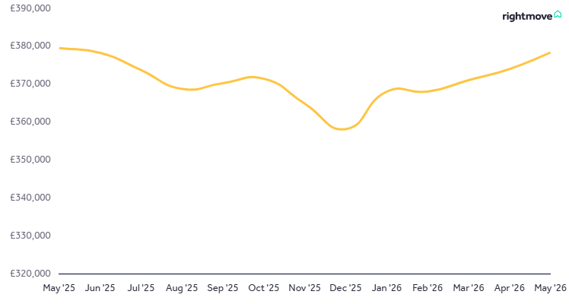
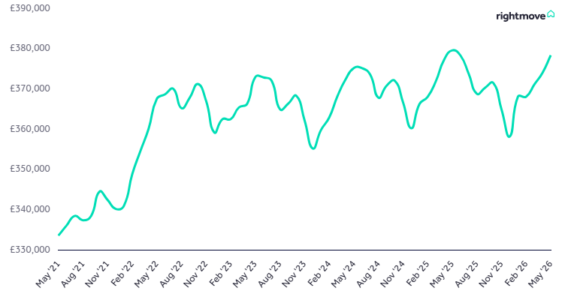
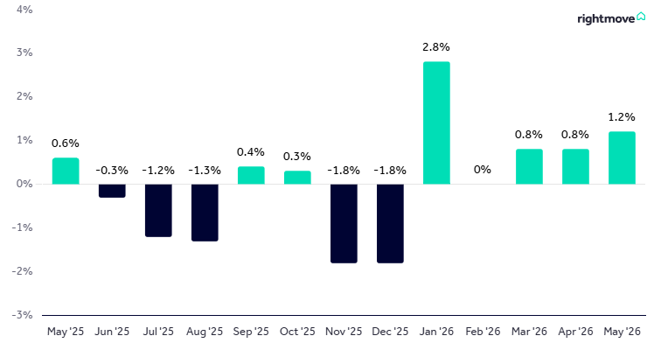
Monday 18th May 2026
Page 4
Price & activity trends
Copyright © 2026, Rightmove plc. Released 18th May. For media enquiries and interviews please contact the Rightmove press office:
M 07980 721032 E press@rightmove.co.uk

Slide 5
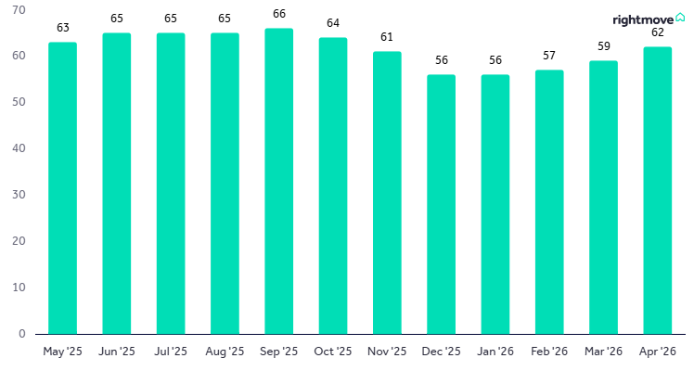
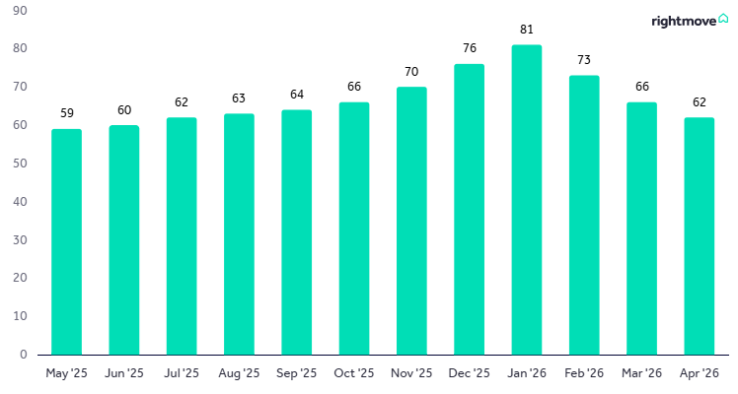
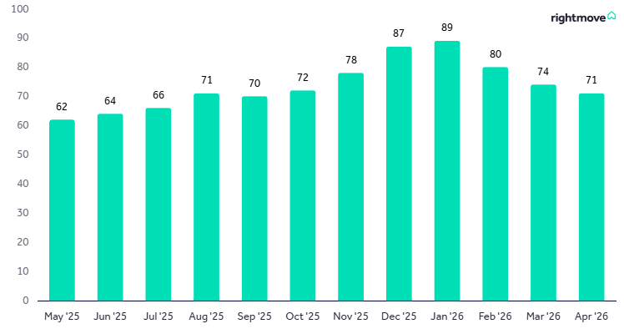
Monday 18th May 2026
Page 5
Copyright © 2026, Rightmove plc. Released 18th May. For media enquiries and interviews please contact the Rightmove press office:
M 07980 721032 E press@rightmove.co.uk

Slide 6
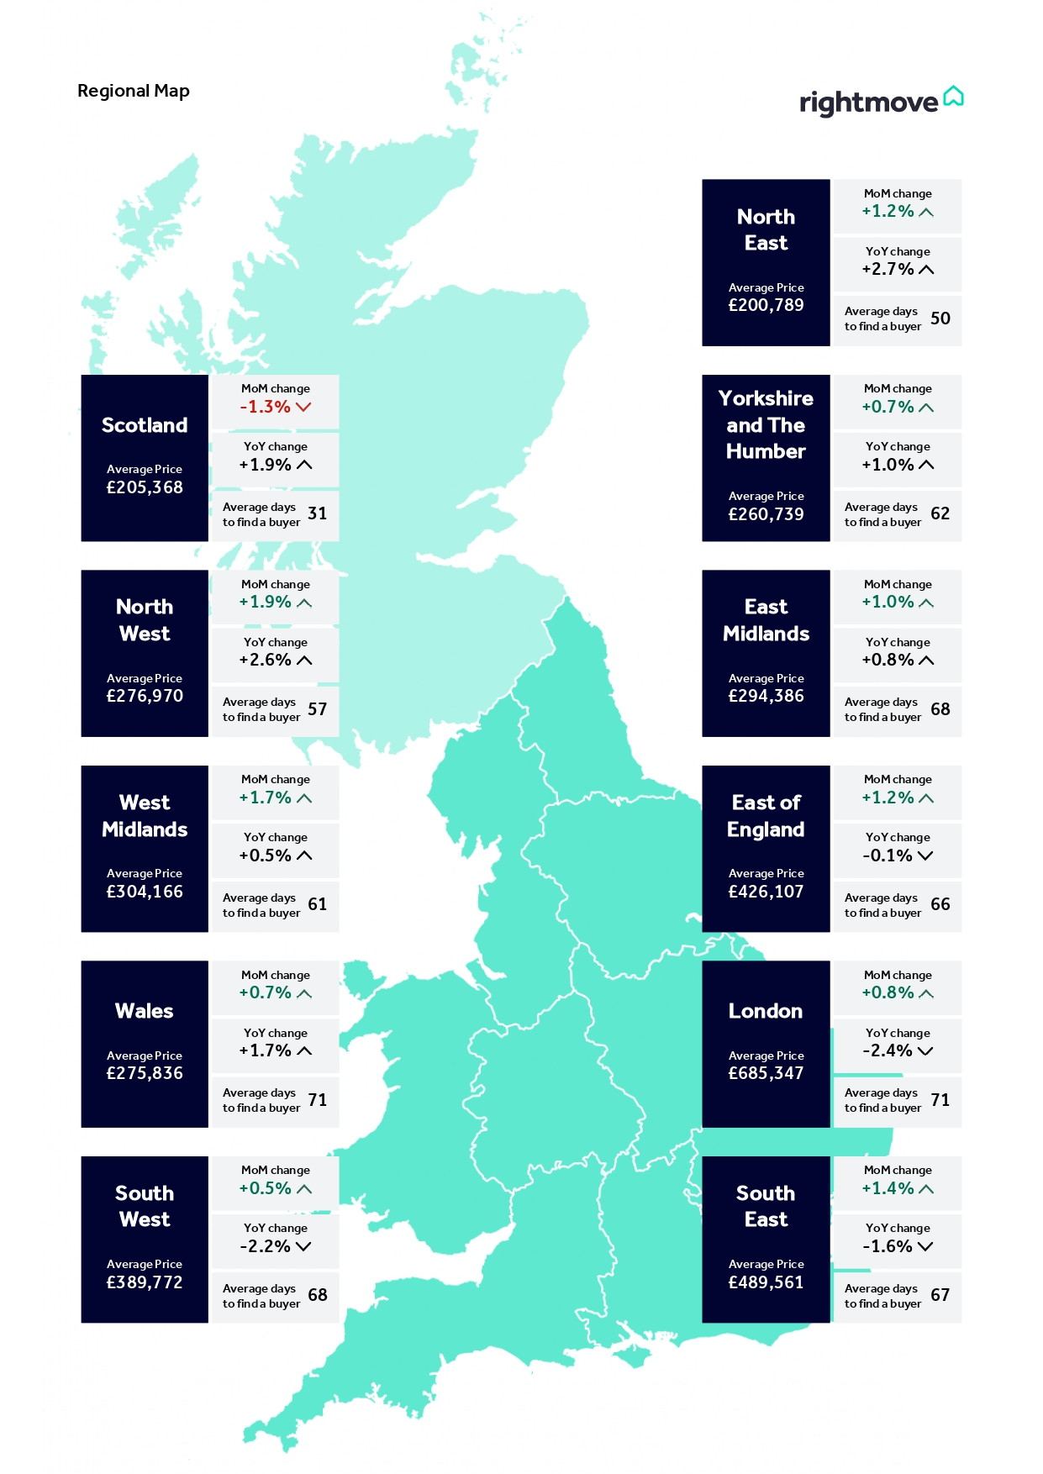
Monday 18th May 2026
Page 6
Regional trends
Copyright © 2026, Rightmove plc. Released 18th May. For media enquiries and interviews please contact the Rightmove press office:
M 07980 721032 E press@rightmove.co.uk

Slide 7
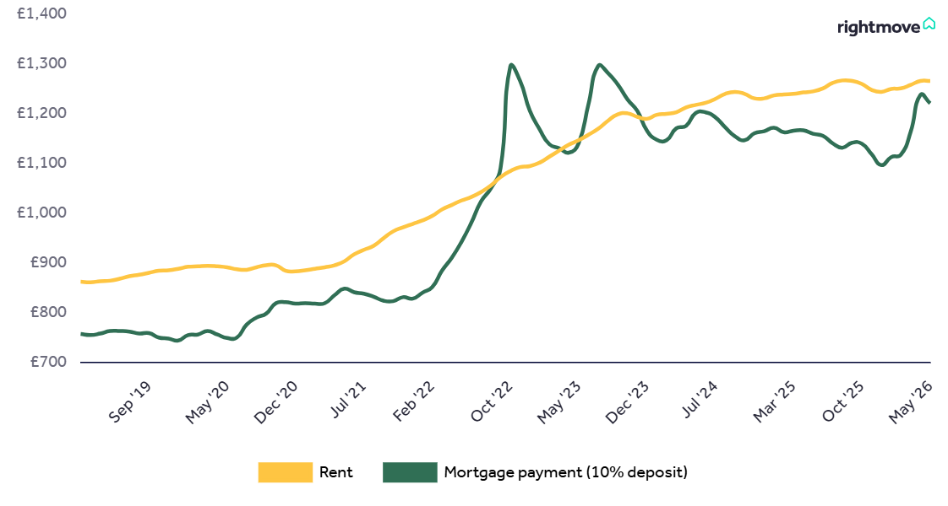
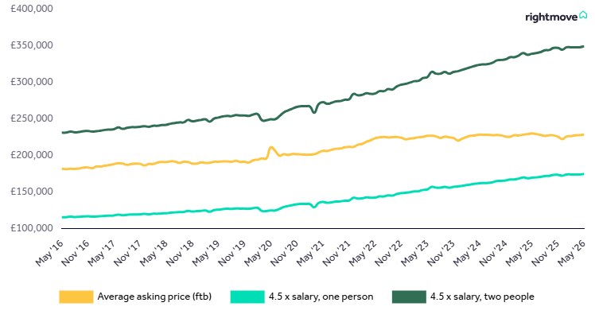
Monday 18th May 2026
Page 7
Affordability trends
The first-time buyer monthly mortgage payment is based on Bank of England data of the averages for 90% LTV two-year fixed mortgages from lenders, and the average asking price of a typical first-time buyer home (two bedrooms or fewer) using the Rightmove House Price Index. The equivalent monthly rent is calculated using the same property types (two bedrooms or fewer).
The affordability to buy a first home is based on the Average Weekly Earnings (AWE) dataset from ONS multiplied by 4.5 to get the typical maximum that a person can borrow from a lender. The average asking price of a typical first-time buyer home is taken from the Rightmove House Price Index.
Copyright © 2026, Rightmove plc. Released 18th May. For media enquiries and interviews please contact the Rightmove press office:
M 07814 902 706 E press@rightmove.co.uk

Slide 8
Monday 18th May 2026
Page 8
London boroughs
Borough data is based on a three-month rolling average and can be used as an indicator of overall price trends in each borough over time. It is not directly comparable with the overall London monthly figures.
Borough | Avg. price May. 26 | Monthly change | Annual change
Havering | £493,432 | 0.6% | 1.5%
Enfield | £514,050 | 0.2% | 1.4%
Barking and Dagenham | £380,934 | 0.3% | 1.0%
Redbridge | £520,593 | 1.0% | 0.9%
Waltham Forest | £585,747 | 0.3% | 0.7%
Harrow | £635,386 | -1.6% | 0.7%
Sutton | £559,333 | -0.5% | 0.3%
Bexley | £484,717 | 0.3% | 0.3%
Croydon | £485,119 | 0.5% | 0.0%
Bromley | £634,283 | 0.3% | 0.0%
Haringey | £701,302 | 0.6% | -0.6%
Hackney | £725,081 | 0.3% | -0.7%
Kensington and Chelsea | £1,673,706 | 2.3% | -0.7%
Hounslow | £606,644 | 1.1% | -0.8%
Ealing | £610,818 | -0.2% | -1.1%
Newham | £464,100 | -1.0% | -1.3%
Richmond upon Thames | £992,534 | 2.2% | -1.4%
Lewisham | £526,961 | -0.1% | -1.5%
Hillingdon | £561,143 | 0.6% | -1.8%
Merton | £730,895 | -0.1% | -2.5%
Lambeth | £663,268 | 0.0% | -2.8%
Tower Hamlets | £586,744 | 0.3% | -2.8%
Greenwich | £506,736 | -0.1% | -3.1%
Wandsworth | £854,976 | -0.1% | -3.2%
Brent | £610,759 | -0.5% | -3.4%
Islington | £818,795 | 1.2% | -3.5%
Kingston upon Thames | £698,213 | -0.1% | -3.8%
Barnet | £708,885 | 1.7% | -4.2%
Southwark | £648,972 | 0.5% | -4.5%
Hammersmith and Fulham | £979,312 | -0.3% | -6.0%
Westminster | £1,383,111 | -2.3% | -6.9%
Camden | £1,010,020 | -0.9% | -8.1%
Copyright © 2026, Rightmove plc. Released 18th May. For media enquiries and interviews please contact the Rightmove press office:
M 07814 902 706 E press@rightmove.co.uk

Slide 9
Monday 18th May 2026
Page 9
About the Index
The Index includes asking price breakdowns in the housing market to offer trends at three different sectors of the market: first-time buyer, second-stepper and top of the ladder. Inner London prices have been excluded from this categorisation as the normal housing ladder is not really applicable. The Rightmove House Price Index methodology was last updated and restated in January 2018.
Rightmove is in a unique position to identify any immediate changes in the market. Rightmove’s House Price Index is compiled from the asking prices of properties coming onto the market via over 16,000 estate agency branches listing on Rightmove.co.uk. Rather than being a survey of opinions as with some other indices, it is produced from factual data of actual asking prices of properties currently on the market. The sample includes up to 200,000 homes each month, making it the largest and most up-to-date monthly sample of any house price indicator in the UK. The Index differs from other house price indicators in that it reflects asking prices when properties first come onto the market, rather than those recorded by lenders during the mortgage application process or final sales prices reported to the Land Registry. In essence, Rightmove’s Index measures prices at the very beginning of the home buying and selling process while other indices measure prices at points later in the process. Having a large sample size and providing real-time data, the Rightmove Index has established itself as a reliable indicator of current and future trends in the housing market.
First-time buyer: This figure represents the typical property a first-time buyer would purchase, covering all two bed properties and smaller that come to market (houses and flats).
Second-stepper: This figure represents the typical property of a person moving from their first home, covering all three and four bed properties that come to market (houses and flats) excluding four bed detached houses.
Top of the ladder: This figure represents asking prices at the top end of the market, covering all five bed properties and above (houses and flats), as well as four bed detached houses.
Rightmove is the UK’s leading property portal, advertising homes and commercial property for Estate Agents, Lettings Agents and New Home Developers from the UK and Overseas. Rightmove’s vision is to give everyone the belief that they can make their move by giving people the best place to turn and return to for access to tools and expertise to make it happen, including a Mortgage in Principle, local sold prices, property valuations, market trends, maps and schools.
Average mortgage rates to be credited to Rightmove. The data is provided by specialist mortgage technology provider Podium Solutions. The data covers 95% of mortgage lending, to exclude specialist lenders. If you would like further data on different LTVs or fixed terms, please contact us.
Rightmove’s Confidence Tracker is based on a nationally representative sample of 1000 home-owners, renters, prospective first-time buyers and landlords each month. It measures sentiment towards the market and asks participants whether they think it is a good time or a bad time. Net confidence is the difference between those seeing it as a good time versus a bad time.
Copyright © 2026, Rightmove plc. Released 18th May. For media enquiries and interviews please contact the Rightmove press office:
M 07814 902 706 E press@rightmove.co.uk

